Slide 1
IP strategy tk: Create effective IP coverage for our businesses efficiently
Effective IP coverage to secure our businesses
Create a common IP shield
Stimulate & Incentivize IP creation
Give direction and IP focus
Understand competitive IP environment
Efficiently created IP
Have the business decide on IP
Build IP community & create awareness
Manage brands strategically as part of IP
Manage external services and insource

Slide 2
Create a common IP shield
TK AG and LE
have declaratoric
ownership
Only legal entity
has economic
ownership
Model
TK AG
Legal entity
Trustee contract
Representation at patent office
(patent filing)
Representation at court
(infringements)
Representation at customers / partners
(licencing)
Inventing legal entity
How it works
Internal and external licencing agreements need to be signed by legal entity & TK AG
TK AG
TK AG represents legal entity at patent office
In most cases TK AG represents legal entity in court of law
External
Patent office
Court of law
Customer / competitor / LE

Slide 3
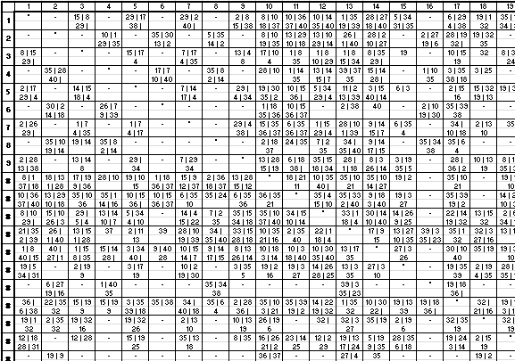
Create inventions systematically by use of TRIZ
Fundamental ideas
List of principles
40 principles of problem solving
39 technical parameters
Principles solve contradiction of parameters
Segmentation
Extraction
Local quality
Asymmetry
Combination
Universality
Nesting
Counterweight
Prior counteraction
Prior action
Cushion in advance
Equipotentiality
Inversion
Spheroidality
Dynamicity
Partial, overdone or excessive action
Moving to a new dimension
Mechanical vibration
Periodic action
Continuity of useful action
21. Rushing through
22. Convert harm into benefit
23. Feedback
24. Mediator
25. Self-service
26. Copying
27. Inexpensive short life
28. Replacement of a mechanical system
29. Use pneumatic or hydraulic systems
30. Flexible film or thin membranes
31. Use of porous materials
32. Changing the colour
33. Homogeneity
34. Rejecting and regenerating parts
35. Transforming physical or chemical states
36. Phase transition
37. Thermal expansion
38. Use strong oxidisers
39. Inert environment
40. Composite materials
Contradiction matrix
Neg. parameter
Suggested principles of problem solving
Pos. parameter
List of technical parameters
Weight of moving object
Weight of stationary object
Length of moving object
Length of stationary object
Area of moving object
Area of stationary object
Volume of moving object
Volume of stationary object
Speed
Force
Stress or pressure
Shape
Stability of the object's composition
Strength
Duration of action by a moving object
Duration of action by a stationary object
Temperature
Illumination intensity
Use of energy by moving object
Use of energy by stationary object
Power
Loss of energy
Loss of substance
Loss of information
Loss of time
Quantity of substance/the matter
Reliability
Measurement accuracy
Manufacturing precision
External harm affects the object
Object-generated harmful factors
Ease of manufacture
Ease of operation
Ease of repair
Adaptability or versatility
Device complexity
Difficulty of detecting and measuring
Extent of automation
Productivity
Method
Describe problem
on abstract level
Use suggested abstract principles of prob. solving
Describe problem
on specific level
Transform abstract principles into specific suggestions

Slide 4
Give direction and IP focus
Technology tree
IP gap
to competitors
Technology focus
of Innovation Dialogue
IP goal
Target portfolio
Own IP
Competitor IP
future IP focus
future IP focus
How can our technologies be sorted ?
How are these technologies covered with own IP ?
How do competitors cover these technologies with IP ?
In which tech-nologies do we have IP gaps ?
In which technolo-gies do we want to invest strategically ?
Thus, where to focus our IP ?

Slide 5
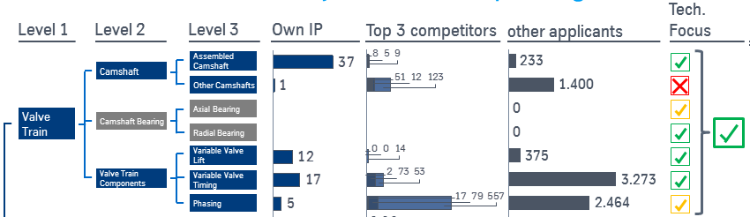
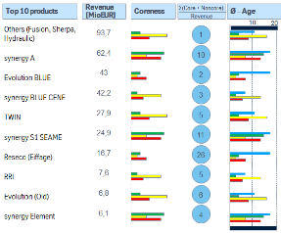
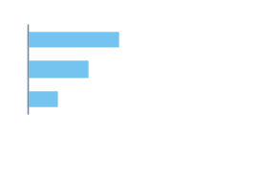

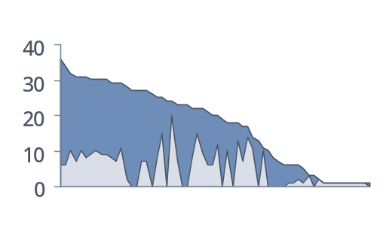
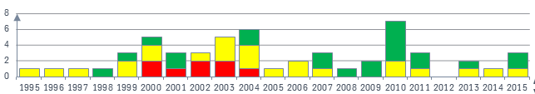
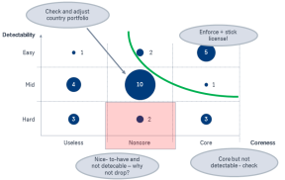
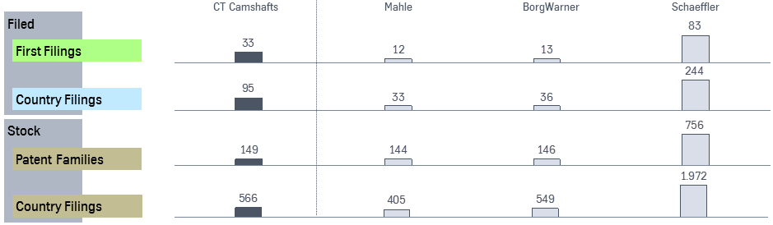
Ensuring IP effectiveness & IP efficiency are the results of the annual IP dialog
Goals
Input/discussions
Results
Effective IP coverage
"Are our businesses protected?"
✓
Innovation dialog
x
New IP foci
✓
Top 5 todays & top 5 future products
Invention on demand workshop planning
Efficiently used IP
"Do we use our IP- resources wisely?"
IP portfolio
Countries
Portfolio decisions
(families, countries) based on
  Coreness
  Detectability
# of countries of a patent family
x
before
after
x
Patent families
Licensing (int./ext.)
Overview licensing income
Licensing strategy
Competitor observation results
Ambition setting
IP budget
TK
A
B
C

Slide 6
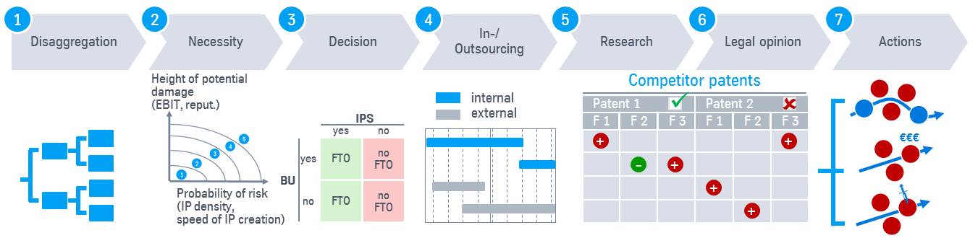
Understand competitive IP environment
Rationals for IP competitor observation
Instruments / Processes
Destroy competitor IP
Continuous monitoring
  Standard process have been defined
  Trainings for IP Coordinators and Evaluators have taken place
  Filters are being sharpened
Legal Status monitoring
  Is necessary to file oppositions against "hostile" patents which have been granted
  By switching this process from external IP law firms to Thomson Innovation significant savings achieved
FTO searches (only by IPS)
  Necessary for all new products, new market entries or new production facilities to ensure freedom to operate for Bus
Filing of patent
Patent not published
Publication
Publication of patent filing
Grant
Granted patent


18 months
File opposition
File nullity plea

Attack
Get freedom to operate
Understand risk and probability
Decide necessity and degree of FTO
Develop around or take licence





* as for patents and trademarks, all IP-/patent related researches need to be conducted by /
ordered thru IPS in order to ensure quality and consistency

Slide 7
Understand competitive IP environment
Overview of Methods for IP Valuation
Why IP Valuation ?
Methods for IP Valuation
M&A
Licencing
Accounting
Controlling / KPI
Purchasing
Sales
Cooperations
Investor Relations
Liquidation / Insolvence
typically used for
young patents
Cost-based methods
Patent value =
Advantages / Disadvantages
Effort needed
Sum of historic costs for filing and maintaining
simple to apply, clear value
Not related to income, very imprecise (costs ≠ value)
Cost controlling of application
Low effort for determination
typically used for
mature patents or portfolios
Income-based methods
Patent value =
Advantages / Disadvantages
Effort needed
WACC-discounted sum of future internal and external cash flows
well-established
many parameters to be determined
Knowledge about possible income
Influenced by many parameters
typically used for
larger portfolios
Market-based methods
Patent value =
Advantages / Disadvantages
Effort needed
Value of recent other portfolio transaction adjusted by multiples
Future use is considered
Deep knowledge about his-torical transactions needed
Offer patent to market
Collect information about comparable transactions
typically used for
IP in pharma
Option pricing
Patent value =
Advantages / Disadvantages
Effort needed
Real option value of patent taking into account future options
Low starting cash-flows and high risks can be assessed
Raw data difficult to assess
Difficult calculation, many parameters

Slide 8
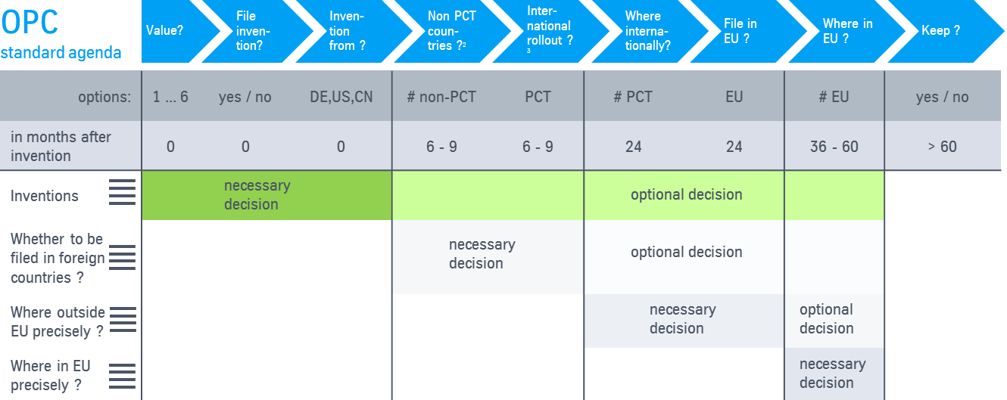
Have the business decide on IP: Within the Operative Patent Councils all IP decisions are taken by the Business Units, then handled by IP Services
BUs
Own IP economically
Decide about IP coverage
Operative Patent Council
Head of R&D
Head of M&S
IP Coordinator
TM Coordinator *
Typical organizational embedment
  Part of R&D/TIS organization
  Part of M&S, COM or PLM organization
Main contact points within BU
  Contact to all inventors
  Contact to M&S, COM & PLM people
Responsibility within OPC
  Proposes patent decision to OPC
  Proposes trademark decision to OPC after approval from BA/COM
Primary contact with IPS-organization
  Acts with patent lawyer within IPS
  Acts with trademark lawyer within IPS
Standard
OPC tool
& discussion
process
* responsible for trademarks and domains

Slide 9
Create IP awareness: IP in every contract
Cooperation
partners
Academic partners,
specifically in Germany
Group
Employees
Suppliers
Customers
Aspects
to be considered
Include IP clauses to ensure ownership of inventions for tk legal entity in
  CEO contracts
  contracts with graduands
  contracts with interns
  contracts with every person not covered by German "Law on Employee Inventions"
Include "hold-harmless-clause" regarding infringe-ment of 3rd parties IP, e.g.
  other suppliers
  all pre-suppliers
  other customers
Freedom to assign 2nd source to deliver goods using suppliers IP
Defined fractions of ownership
Clear rules and clauses who is allowed to use the results (what, when, how, where)
Ideally freedom for tk regarding
  IP generation
  country portfolio
  licensing
Clear rules for
  background IP
  foreground IP
Cost allocation
Responsibility for filing & prosecution
Inventor remunerat.
Close 2 contracts with
  institute/univ.
  academic personnel
  in order to avoid "negative publication right" of professors for "Diensterfindgen"
  (§42 ArbEG)
Set up publication rules regarding timeframe
Define price for buying inventions from university / professors
Regulate "rights of use" for development results
Exclusion of liability regarding patent infringement
No licenses for tk IP except in special sit.
Regulations concer-ning sublicenses ("no" as default)
Prevent second sources via IP
Limit licenses to
  product
  geograph. region(s)
  time span
  partner (in coop.) kind of use
Additionally IP as topic within catalog of Actions that Require Approval (TRA)
Generating new Intellectual Property Rights (IPR)
Transfer of Intellectual Property
Amendments of contract templates
Disputes relating to Intellectual Property

Slide 10
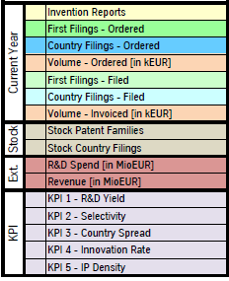
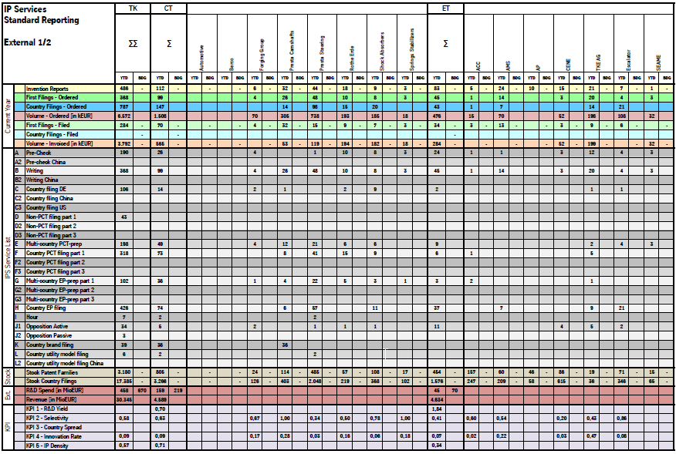
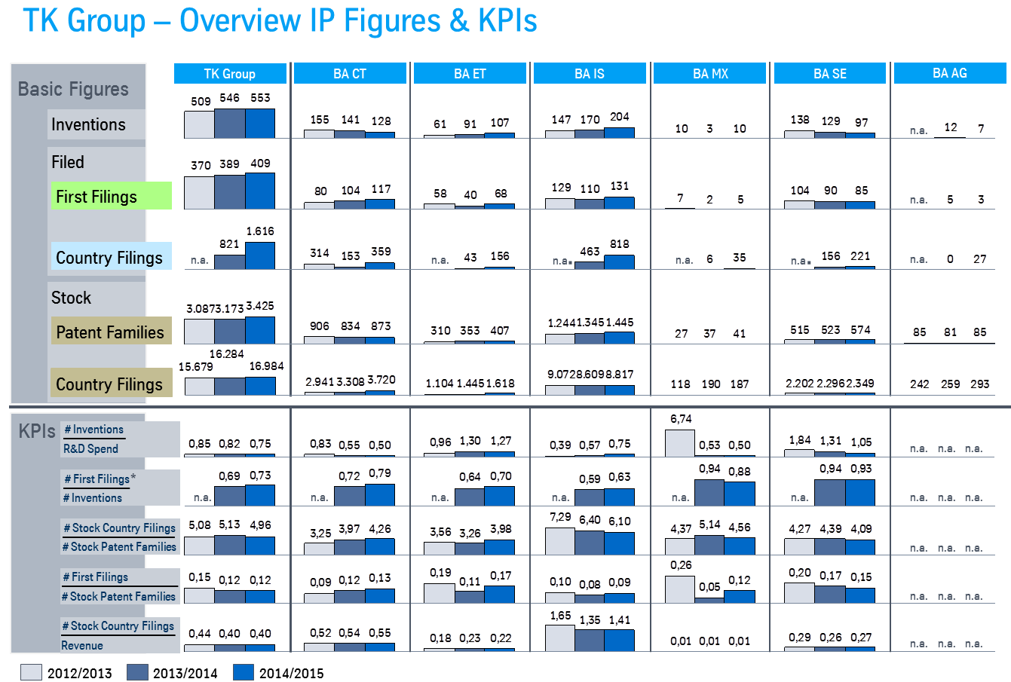
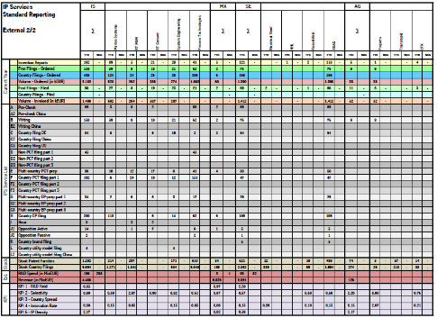
Create IP awareness: KPIs measure achievement of strategic IP goals
Strategic
IP goals
Create inventions
Ensure
IP quality
Develop
IP shield
Renew
IP shield
Benchmark
IP shield
Process
Invention
development
OPC
First filing
Country filing
Stock of
patent families
Stock of
country files
IP
KPIs
# stock of
country files
# inventions
# first filings
# country files
# first filings
R&D spend
# inventions
# first filings
# stock of
patent families
Revenue
R&D
yield
Selectivity
Country
spread
Innovation
rate
IP density
Quarterly reporting
Yearly full reporting of all IP KPIs for discussion with CTOs & R&D heads
Basic figures
Quarterly standard IP reporting
Annual IP reporting

Slide 11
Steps towards Vision for IP
Vision 2020
2016
2015
2014
IP Effectiveness | Licencing |  | Internal licencing | External licencing |  | Businesses are supported to generate licencing revenues
 | Products |  |  | Product coverage analysis started |  | 80% of relevant revenue secured by IP
 | Technologies | Technology Trees | IP focus defined | IP focus revisited |  | All major technologies secured by IP
 | Inventions | Invention-on-Demand workshops | TRIZ | New formats (fast-track) new topics (spare, IT, ..) |  | 500+ First Filings p.a.
 | Inventors | Inventor Incentive | IP risk reduction | Flat fee inventor Remuneration |  | All tk inventors incentivized / remunerated
 | IP Decisions | Operative Patent Councils | All IP decisions in OPCs (FTOs, InvRemun, ..) | Operative: tk IP portal Strategical: IP Dialog |  | Informed IP decisions
 | Brands |  | tk brand filed | All brands known brand protection processes set up |  | tk trademarks protected
IP Efficiency | IP community | IP coordinators named, 1st global training conducted | Local IP coordinators | TM coordinators existing |  | Informed, co-working IP community
 | Competitor IP |  | Thomson Innovation implemented | 600 users IP research dept started |  | Competitor IP known
 | IP law firms | Negotiations Germany & international | Annual reviews & portf. optimization |  |  | -
 | Insourcing | IP board | tk IP GmbH | 35% |  | 60%
 | Governance | tk AG board proposals |  | TRA catalog |  | -

