Slide 1
THE EXPERIENCE OF ZAMBIA ON TRANSFER, DEVELOPMENT, ADAPTATION AND ACQUSITION OF TECHNOLOGY
A Presentation by
Lloyd Samson Thole
IP Expert, Zambia.
National Meeting on the Implementation of the WIPO Development Agenda Project: Capacity Building in the Use of Appropriate Technology-Specific Technical and Scientific Information as a Solution for Identified Development Challenges in Uganda
Kampala, 11 and 12, 2015

Slide 2
Introduction
Zambia signed agreement with WIPO in 2012;
PACRA focal point organization for WIPO and was tasked with forming a multi-disciplinary group which would work as an advisory committee.
Formed NEG chaired by PACRA with membership from Agriculture, Health, Science and Technology, R&D institutions, universities, Early learning and the Private Sector;

Slide 3

Signing ceremony

Slide 4
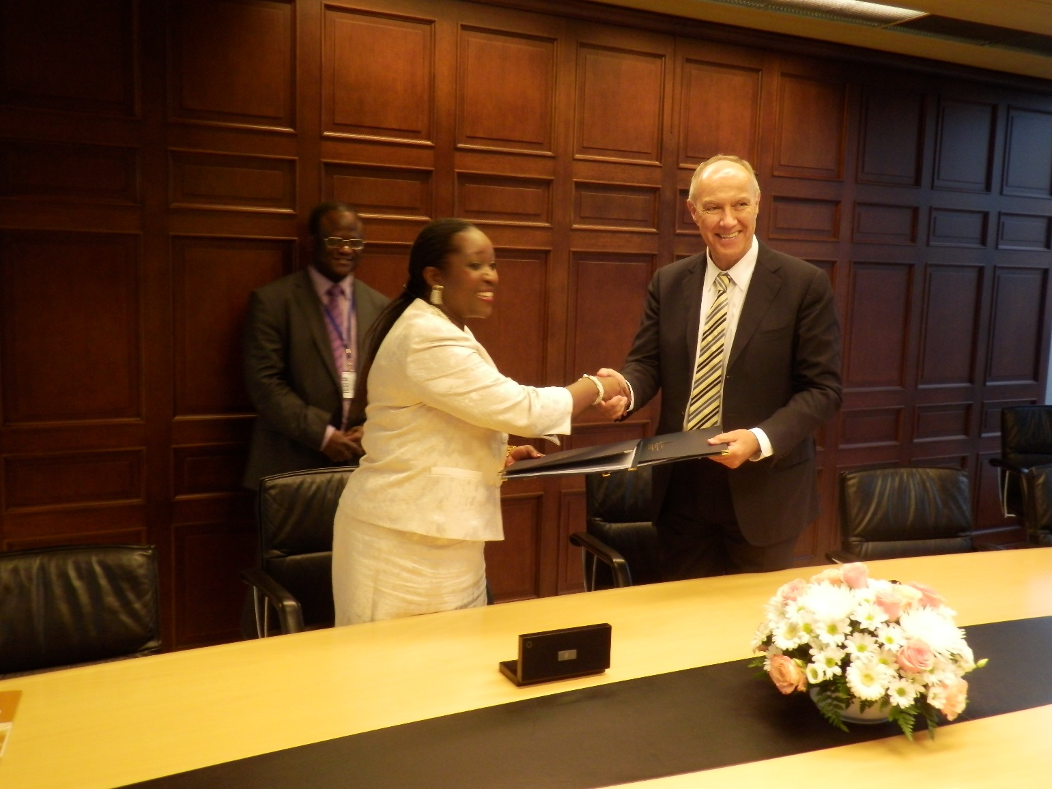
Signing ceremony

Slide 5
Introduction Cont’d
The National Experts Group was appointed with the following objectives:
  To convene meetings regularly and research on most appropriate technologies suitable to solve developmental challenges
  Produce Patent Search report and present to WIPO
  Compile the landscape report and present any findings to the multidisciplinary stakeholders group
  Evaluate patent citations and recommend most appropriate technologies suitable for Zambia

Slide 6
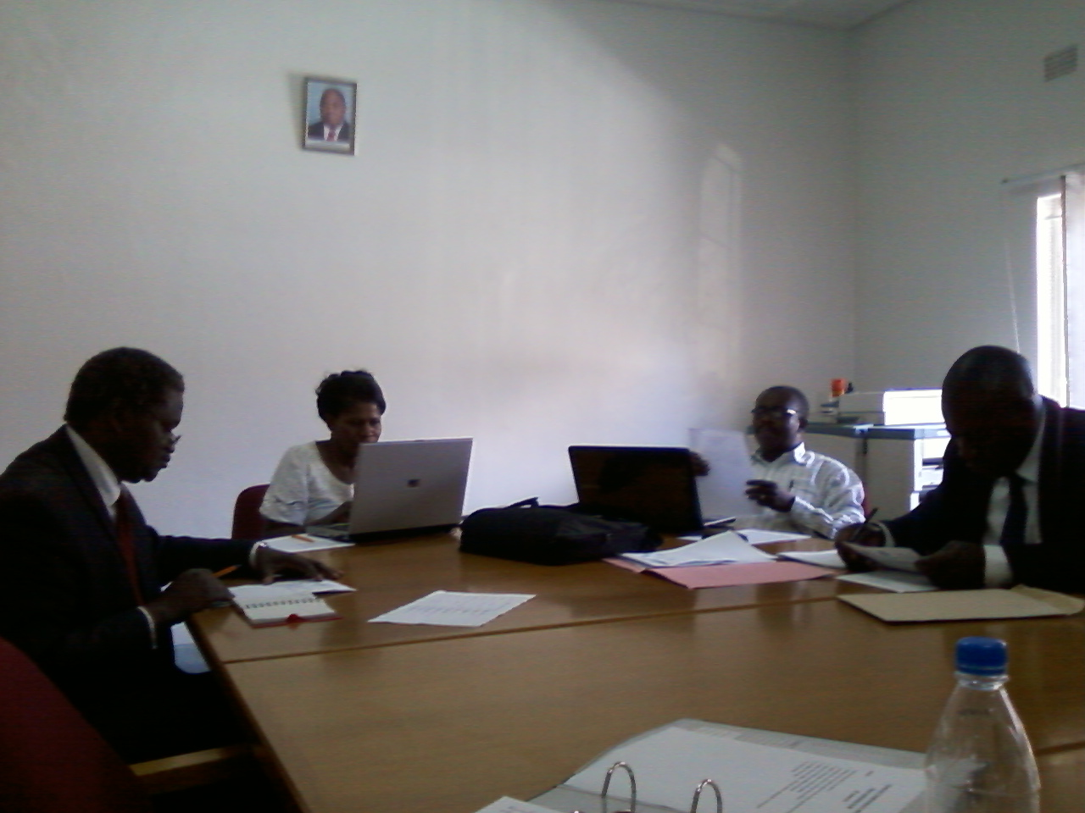
NEG discussions

Slide 7
Introduction Cont’d
Held a number of meetings to come up with appropriate areas of intervention;
Used the 6th NDP of Zambia, vision 2030 and other documents to identify areas which needed intervention;
Received training in patent searches from WIPO;
Identified problem of lack of abundant and clean water in some parts of the country.

Slide 8
Introduction Cont’d
Settled on Two projects:
  Run-off rainwater harvesting
  Solar water distillation
Carried out Patent searches to identify appropriate technologies in public domain and adapted to our local situation;
Siavonga identified as the place where the projects can be implemented on pilot scale;
Developed a Landscape Report and a Business Plan Report for the implementation of the project;
Commenced implementation after approval from WIPO.

Slide 9
Introduction Cont’d
Zambia thereafter commenced the implementation of the innovative run off rain water harvesting technology in the drought stricken area of Simamba Village in Siavonga on a pilot scale after seeking permission from DC and area Chief;
Implementation committee formed in the DC’s office;
Preliminary investigative scientific and technical surveys concerning the area’s geographical location, topography, current impoundment capacity, foliage, evaporation rates and seepage tests were conducted.

Slide 10
Introduction Cont’d
These surveys were taken in order to determine the causes of premature drying up of the impoundment before the onset of the rains and to assess the suitability of the area for implementing the innovative run off rain water harvesting technology.
The impoundment dries up earlier than anticipated each year before the onset of the rains and this trend has negatively affected animal rearing and agricultural productivity in the area.
The surveys were conducted over a period of two weeks by agriculture, sociology and irrigation experts.

Slide 11
Business Plan
Financial Viability- A business plan was developed based on assumptions and pro-forma financial statements produced showing the Internal Rate of Return (IRR)
Net Present Value (NPV) and Pay Back Period was determined.
A report was written as this was necessary in order to attract investment.

Slide 12
Water Demand In The Simamba Village
According to the hydrological survey, the water demand in Simamba area is categorised in 2 consumption groups as follows:
Domestic Use 1,512 m³
Animal Use 6,930 m³
The loss of water in the impoundment at the moment through evaporation and seepage accounts for more than 50 per cent of the stored capacity.
Evaporation 4,221 m³
Seepage 2,612 m³

Slide 13
Topography Of The Chosen Site
The land in the area recommended for application of our technology slopes at approximately 5º to the south west and it is characterised by several ephemeral channels that become loaded with water during the rainy season and flows towards the impoundment.
The topography within the Zambezi rift valley is undulating to flat with isolated elongated north-east south-west trending ridges composed of more resistant out crops of the basement rocks.

Slide 14
Rain Fall Pattern
The rainy season starts in the month of October and continues up to March.
The Siavonga area which is located in the Southern Province in general receives very little rain fall compared to the northern, eastern, western and central parts of the Zambia.
The climate is hot and dry reaching a maximum peak in October and November, the mean annual temperatures is around 25º C.
The rainfall patterns are often erratic and the mean annual rainfall ranges between 300mm to 800mm.

Slide 15
Type Of Foliage
Siavonga has the savannah type of grassland with mainly alluvial sands supporting the growth of Mopani woodlands.
Stunted elephant grass (Hyperennia) and trees are symbolic of low rain fall experienced in the area.
Siavonga has the Mopani woodlands with such trees as kigelia, lonchocarpus and trichillia becoming prominent in the area.

Slide 16
Evaporation
One of the major causes of drying up of the impoundment is evaporation which is responsible for about 40% of total water losses.
Evaporation is normally enhanced when there are high temperatures as well as high wind speeds.
  Temperature
  The average temperature in Siavonga ranges from a low of 29º C in April and increases to an average of 44º C in October.

Slide 17
Evaporation
  Wind speed
High wind speeds in the area are responsible for evaporation even though there are some shrubs around the impoundment acting as a wind breakers.
The wind speed is estimated at an average of 15km per hour during the month of July and August.

Slide 18
Impoundment
Capacity
The current capacity of the impoundment at the peak of the rainy season is 4,000 m³ which falls short of the recommended demand of 20, 000 m³. This means that in future, the government will have to consider meeting this demand to satisfy the needs of the community.
Seepage
The rate of seepage depends on the type of soil of the impoundment floor and for this particular site; the soil is sandy loam which has a seepage rate of 2mm per day.

Slide 19
Remedial Measures
The problem of seepage cannot be ignored wherever you have a dam, pond, lake or any pool of water collected.
Seepage can be controlled by putting a layer of bentonite on the floor of the impoundment or using dam lining.
However, considering the rate at which the water was lost even when temperatures and wind speeds were low this year, we cannot rule out another form of loss of water called piping.

Slide 20
Remedial Measures
Piping is loss of water caused by soil erosion through the embankment which is a very common feature for such water impoundments that use earth barriers.

Slide 21
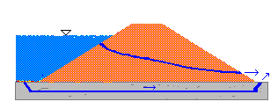
Remedial Measures
Piping is started by soil erosion which normally occurs at the downstream toe and forms channels or pipes through the embankment. The bottom of the impoundment as well as the curtain receives a lot of water pressure due to sloping of the floor creating a deep end effect.

Slide 22
Remedial Measures
Evaporation:
  Evaporation of water from impoundments can be reduced using chemical monolayers for large impoundments but for small impoundments, floating or suspended evaporation barriers can be used and these range from grass thatch covers and floating cloth membranes, timber, used tyres are placed on the surface of the water to reduce contact of wind with water.

Slide 23
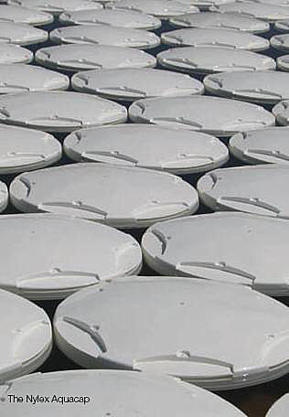
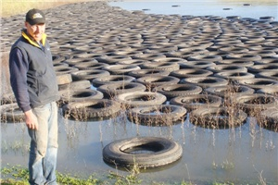
Examples
Used Tyres
Aqua cap

Slide 24
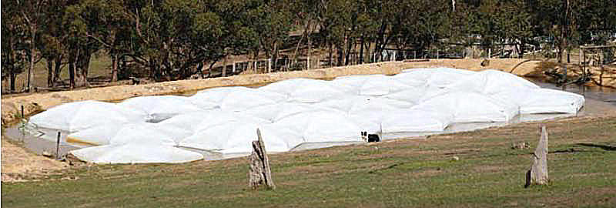
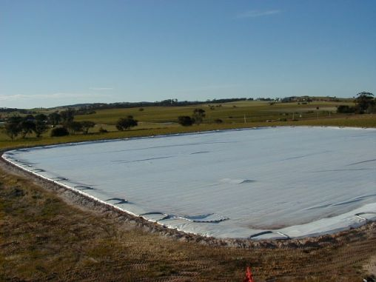
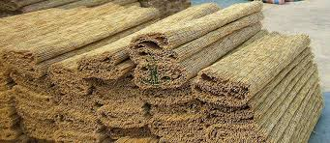
Examples
Raftex cover
Reed Mats
Evap Cap

Slide 25
Recommended Cover
The use of local reed mats as an evaporation barrier has never been used anywhere in the world and therefore were used in our project
The problem of piping was resolved by use of the dam lining which was laid at the bottom of the impoundment.

Slide 26
Current Position
Work commenced with the clearing of trees and shrubs around the impoundment;
The laying of the dam lining to prevent seepage water through the ground was then done;
This was followed by laying of Reed mats to prevent/reduce evaporation after the dam was filled;
Local labour was engaged for the work to create employment for the locals.

Slide 27
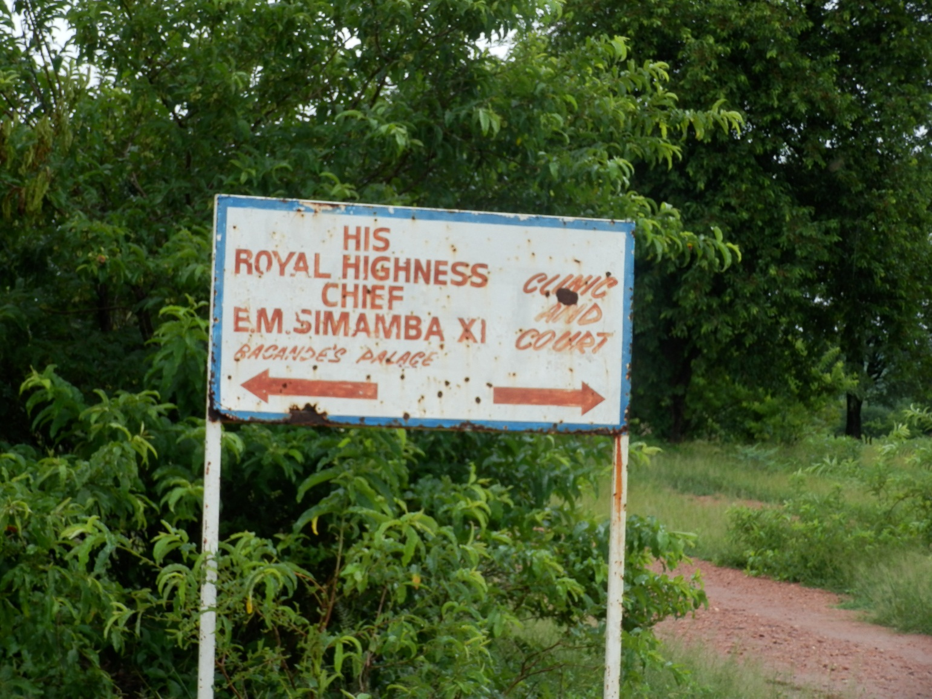
ROAD LEADING TO CHIEF SIMAMBA’S PALACE

Slide 28
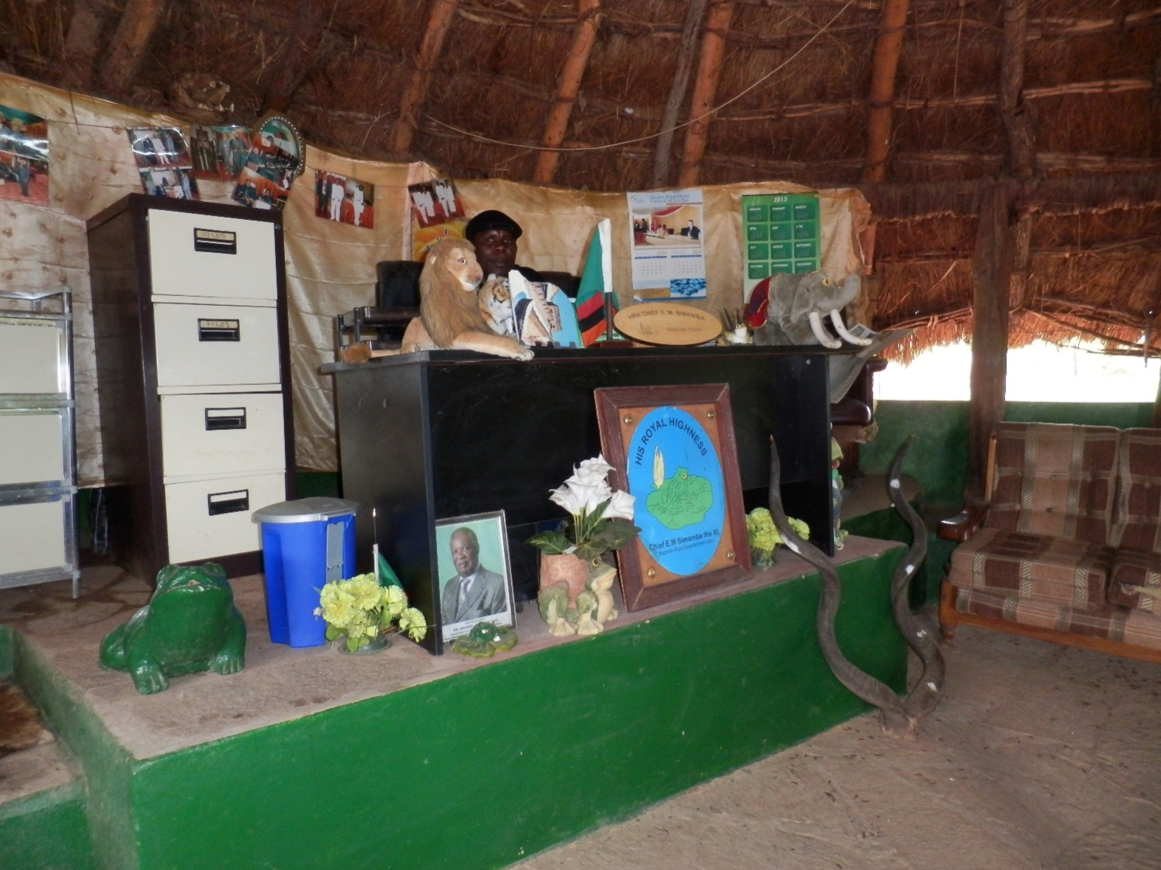
Chief Simamba XI

Slide 29
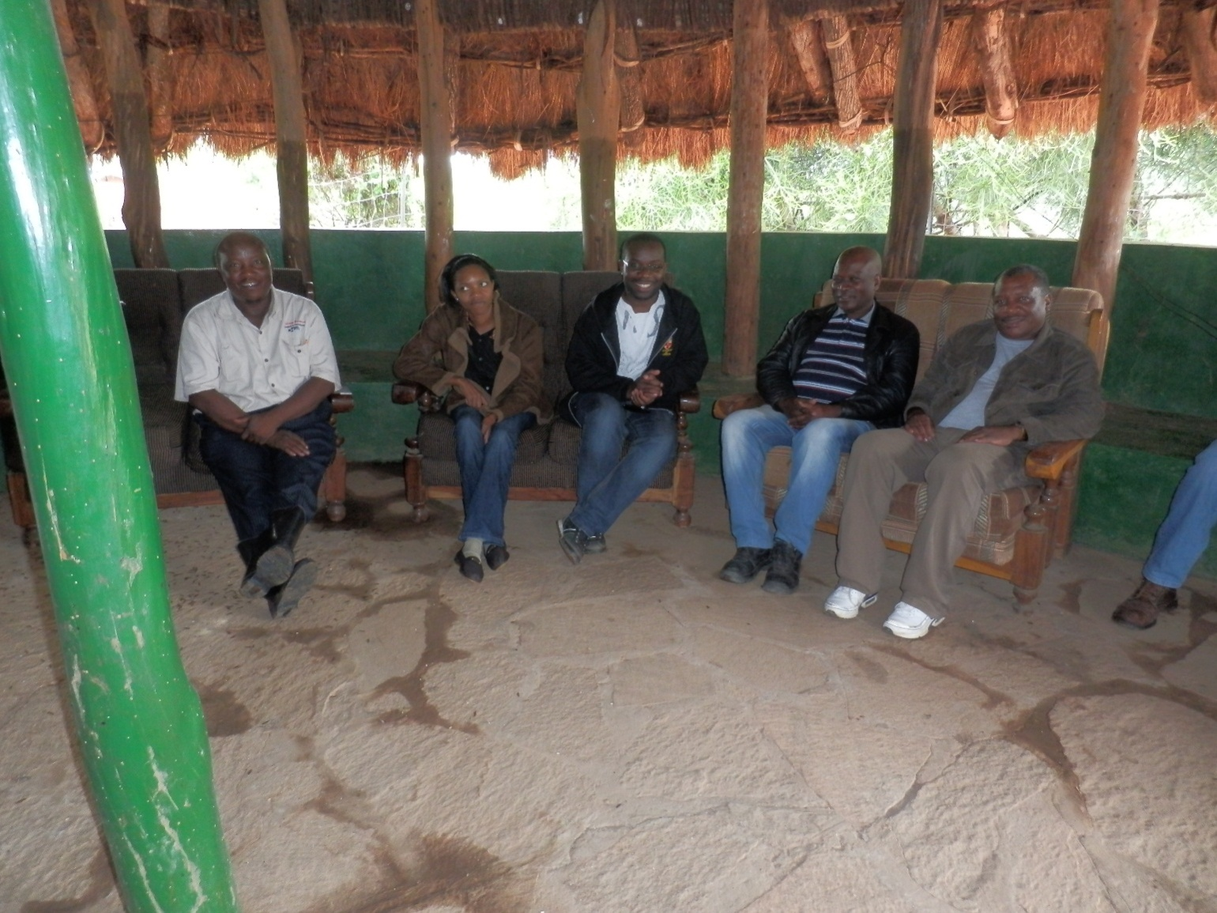
Team meeting the chief

Slide 30
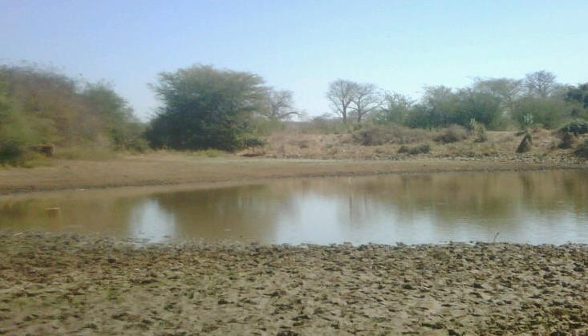
Impoundment in dry season

Slide 31
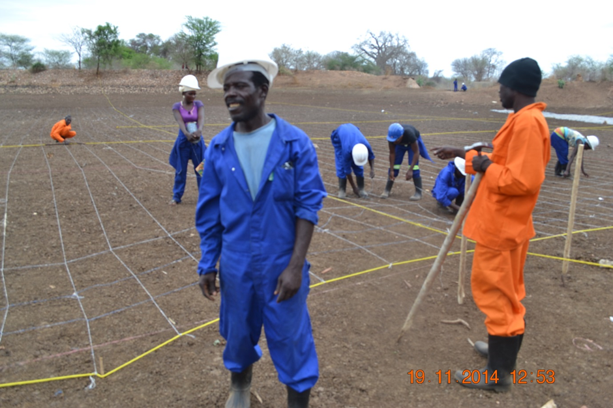
Workers setting up the dam lining

Slide 32
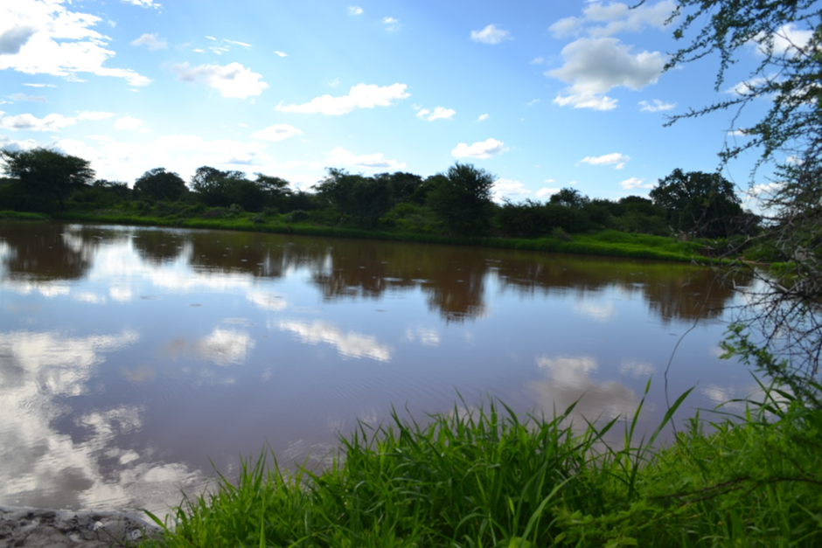
Impoundment filled up in the rain season

Slide 33
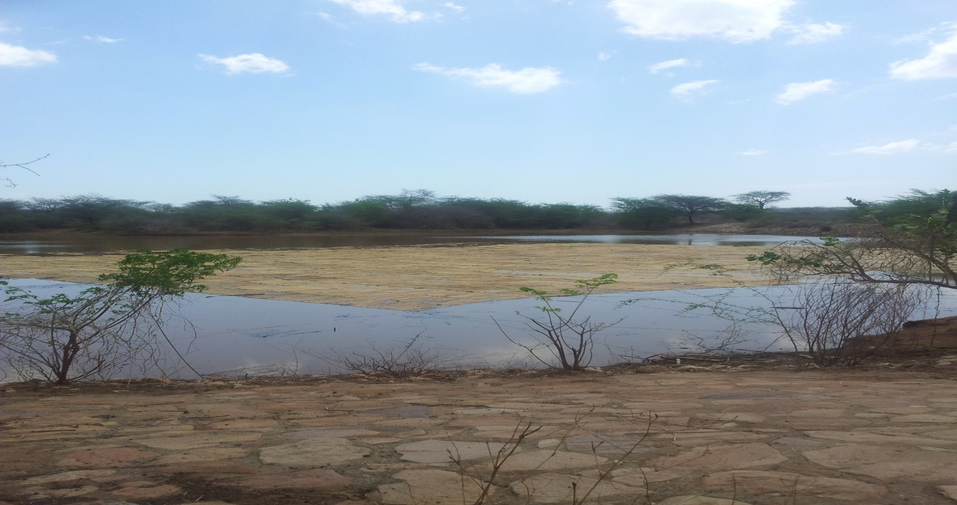
Impoundment with reed mats laid on surface

Slide 34
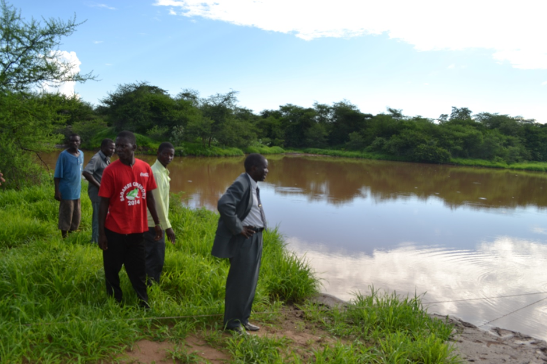
Chief Simamba with subjects

Slide 35
BENEFITS
Up to the month of August, the impoundment still has some water;
The storage facility will enable farmers to grow crops and rear their animals during the dry season;
It is anticipated that this will create jobs and increase the amount of disposable income;
House hold level food security will be ensured (other than agricultural crops, tilapia can be grown in the impoundment)
Portable water will be readily available even in the dry season (although this water has to be purified before use).

Slide 36
RECOMMENDATION
Economic Viability – Once results from the pilot project and financial analysis are positive and acceptable, the Government may source funds to upgrade (upscaling) the pilot project and implement nationwide.
In this regard, an economic analysis report showing the Economic Rate of Return (ERR), and Net National Value Added (NNVA) must be produced.

Slide 37
END
        Thank you for listening !!!

