Slide 1
Managing and Protecting Key Company Assets:
Trade Secrets
Pamela Passman
President and CEO
Center for Responsible Enterprise And Trade
CREATe.org

Slide 2
Intellectual Property as Driver of Growth and Jobs
90% of EU exports consist of product and services of IPR-intensive industries.
Among 269 senior risk managers, 53% said IP loss or theft had inflicted damage on their company’s financial performance —14% cited IP loss as “major” damage
In an EC-sponsored survey of 537 businesses in Europe (EC, 2013), 75% of survey respondents ranked trade secrets as “strategically important to their company’s growth, competitiveness and innovative performance.”

Slide 3
Why The Rise of IP and Trade Secret Theft?
Globalized Marketplace
Fragmented Value Chains
Information Digitalization
Mobile
Workforce

Slide 4
Who is targeting your trade secrets and how?
Intelligence and Security Service Collection
SOEs
Regulations enforcement
Access to sensitive company information through employment or relationships
Nation
States
Malicious Insiders
Types of Threat Actor
Organized Crime Groups
Cyber intrusions
Social engineering
Disgruntled employees
Hactivists
Cyber intrusions
Bribery
Theft
Competitors
Disgruntled employees
Bribery
Theft
4

Slide 5
Malicious Insiders
Impact
Most common source of IP theft
Motivation
Ego, ideology, competition or financial gain
Access
Systems, records, source code, facilities
Connections
Malware, malicious code, social engineering to exploit access
Red Flags
Activity changes with business events, employee departure

Slide 6
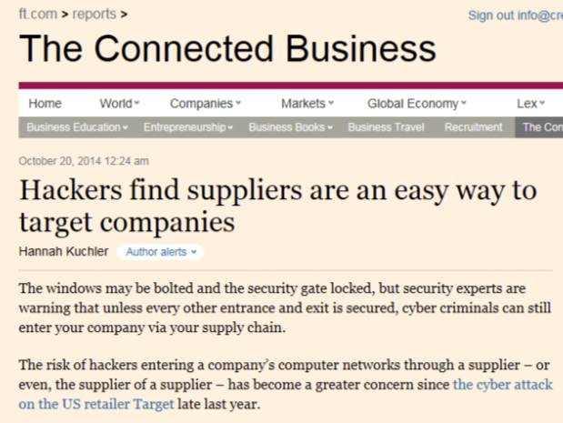

Another Insider: Supply Chain Partners
“The majority of the time, suppliers are the easiest way in”

Slide 7
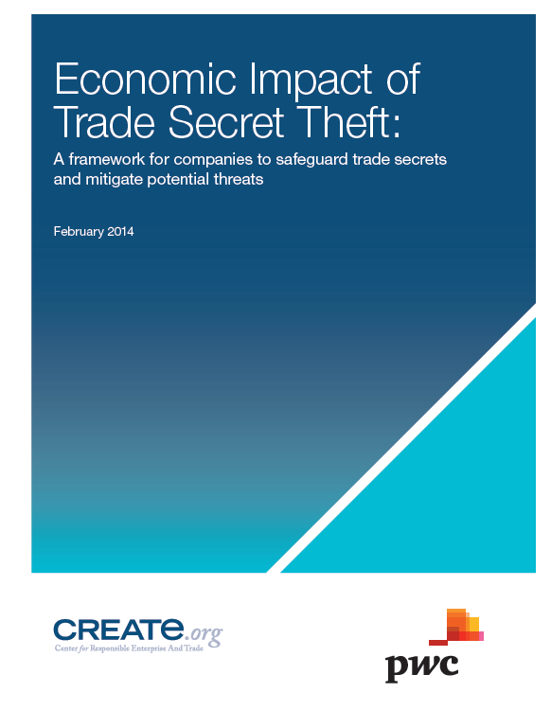
CREATe – PwC Trade Secrets Report
The economic impact of trade secret misappropriation;
An analysis of key threat actors;
Future scenarios of trade secret protection outcomes in 10-15 years;
A five-step framework to help companies assess and safeguard trade secrets.
Available at www.create.org
7

Slide 8
CREATe – PwC Trade Secrets Framework
Five-step framework to help companies assess
and safeguard trade secrets
1
Identify Trade Secrets
2
Assess Threat Actors
3
Relative Value Ranking
4
Economic Impact Analysis
5
Secure Trade Secret
Portfolio
8

Slide 9
Step 5: Securing and Protecting
5
Secure Trade Secret
Portfolio
Enhance ability to secure assets
CREATe Leading Practices for IP Protection
Policies, Procedures & Records
IP Compliance Team
Scope & Quality of Risk Assessment
Management of Supply Chain
Security & Confidentiality Management
Training & Capacity Building
Monitoring & Measurement
Corrective Actions & Improvements

Slide 10

Measure
Improve
1
2
3
Self-Assessment
Independent
Evaluation
Improvement Plan
Online Q&A:
Measures maturity of systems in all categories
Rates maturity on a scale from 1 to 5
Expert evaluation:
Qualifies self-assessment
Reviews documentation
Generates score
Based on rating, company receives:
Improvement steps
Benchmarking report

Slide 11
Summary: Optimizing Trade Secret Protection
Gain consensus across business units over definitions and criteria for determining IP that is a trade secret
Create a prioritized, ranked list of trade secrets with location maps around the world
Define a clear repeatable process for incorporating new innovations and trade secrets into the existing trade secrets list
Use a proven formula for assessing the cost of trade secret theft at the company level
Determine how to maximize the value of protective measures to ensure the greatest return on security investment
Align people, processes and technology to ensure that trade secrets are secret and protected

Slide 12
Ppassman@CREATe.org
For more information about
please contact us at info@create.org

